Slide 1
Brownian Motion(Conti.)
3.4 Quadratic Variation
3.5 Markov Property

Slide 2

Review

Slide 3


Review

Slide 4
3.4 Quadratic Variation
Notes:
In mathematics, quadratic variation is used in the analysis of stochastic processes such as Brownian motion and martingales. Quadratic variation is just one kind of variation of a process.

Slide 5
3.4 Quadratic Variation
continuous derivative
[f,f](T)=0
[f,f](T)=0
ex: |t|
not continuous derivative
[f,f](T) 0
ex:布朗運動

Slide 6
3.4 Quadratic Variation
Notes:
In probability theory, one says that an event happens almost surely (sometimes abbreviated as a.s.) if it happens with probability one.

Slide 7
3.4 Quadratic Variation
We must show that this sampled quadratic variation, which is a random variable converges to T as
We shall show that it has expected value T, and its variance converges to zero. Hence, it converges to its expected value T, regardless of the path along which we are doing the computation.

Slide 8
3.4 Quadratic Variation
The sampled quadratic variation is the sum of independence random variables. Therefore, its mean and variance are the sums of the means and variances of these random variables. We have

Slide 9
3.4 Quadratic Variation

Slide 10
3.4 Quadratic Variation

Slide 11
3.4 Quadratic Variation
Remark 3.4.4. In the proof above, we derived (3.4.6) and (3.4.7):

Slide 12
3.4 Quadratic Variation

Slide 13
3.4 Quadratic Variation

Slide 14
3.4 Quadratic Variation

Slide 15
3.4 Quadratic Variation
Notes:
LLN : http://en.wikipedia.org/wiki/Law_of_large_numbers

Slide 16
3.4 Quadratic Variation

Slide 17
3.4 Quadratic Variation

Slide 18
3.4 Quadratic Variation
The statement is that on an interval [0,T], Brownian motion accumulates T units of quadratic variation.
Brownian motion accumulates quadratic variation at rate one per unit time.
In particular, the dt on the right-hand side of
is multiplied by an understood 1.

Slide 19
3.4 Quadratic Variation

Slide 20
3.4 Quadratic Variation

Slide 21
3.4 Quadratic Variation

Slide 22
3.4 Quadratic Variation

Slide 23
3.4 Quadratic Variation

Slide 24
3.4 Quadratic Variation 3.4.3 Volatility of Geometric Brownian Motion

Slide 25
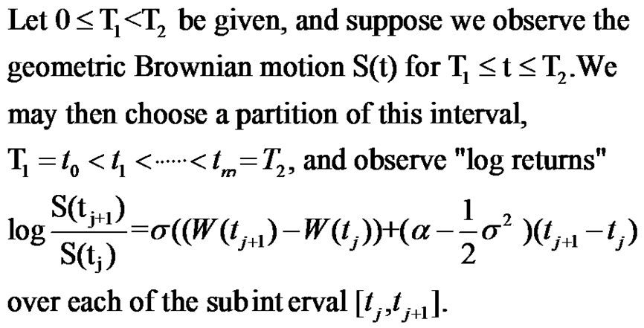
3.4 Quadratic Variation

Slide 26
3.4 Quadratic Variation

Slide 27
3.4 Quadratic Variation

Slide 28
3.5 Markov Property
In this section, we show that Brownian motion is a Markov process and discuss its transition density.

Slide 29
Theorem 3.5.1
Let W(t), t≥0, be a Brownian motion and let F(t), t≥0, be a filtration for this Brownian motion (see Definition 3.3.3). Then W(t),t≥0, is a Markov process.

Slide 30
Theorem 3.5.1 Proof (1)
According to Definition 2.3.6 (Markov process), we must show that
whenever 0 ≤ s ≤ t and
f is a Borel-measurable function,
there is another Borel-measureable function g such that
E[f(W(t))|F(s)]=g(W(s)). (3.5.1)
E[f(W(t))|F(s)]=E[f((W(t)-W(s))+W(s))|F(s)].
The random variable W(t)-W(s) is independent of F(s)
The random variable W(s) is F(s)-measurable
This permits us to apply the Independence Lemma, Lemma 2.3.4.

Slide 31
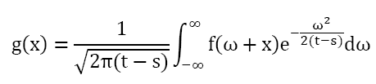
Theorem 3.5.1 Proof (2)
Compute E[f((W(t)-W(s))+W(s))|F(s)]
Replace W(s) by a dummy variable x to hold it constant
Define g(x) = Ef(W(t)-W(s)+x)
W(t)-W(s) is normally distributed with mean=0 and variance=t-s
Therefore,
Replace x=W(s), then the equation E[f(W(t))|F(s)]=g(W(s)) holds.

Slide 32




Let τ=t-s, y=ω+x, then
We define the transition density p(τ,x,y) for Brownian motion to be
So that we can rewrite g(s) as
And E[f(W(t))|F(s)]=g(W(s)) as

Slide 33
Conditioned on the information in F(s)
(which contains all the information obtained by observing the Brownian motion up to and including time s)
The conditional density of W(t) is p(τ,W(s),y)
This is a density in the variable y
This density is normal with mean W(s), variance τ=t-s
In particular, the only information from F(s) that is relevant is the value of W(s)
The fact that only W(s) is relevant is the essence of the Markov property.

Slide 34
Lemma 2.3.4.(Independence)
let be a probability space, and let be a . Suppose the r.v.’s are and the r.v.’s are independent of . Let be a function of the dummy variables and define Then

Slide 35
Def 2.3.6. Continued Def 2.3.5. Consider an adapted stochastic process , Assume that for all and for every nonnegative, Borel-measurable function f, there is another Borel-measurable function g such that
Then we say that the X is a Markov process.

